Slide 1
INTERFACING ICs

Slide 2
CONTENTS
8251
8253
8255
8257
8259
8279

Slide 3
8251
USART(PCI)

Slide 4
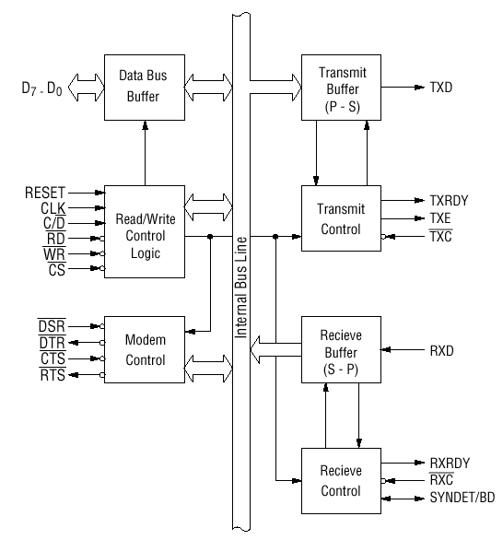

Slide 5
Pin Description
D 0 to D 7 (l/O terminal)
This is bidirectional data bus which receive control words and transmits data from the CPU and sends status words and received data to CPU.
RESET (Input terminal)
A "High" on this input forces the 8251 into "reset status." The device waits for the writing of "mode instruction." The min. reset width is six clock inputs during the operating status of CLK.
CLK (Input terminal)
CLK signal is used to generate internal device timing. CLK signal is independent of RXC or TXC. However, the frequency of CLK must be greater than 30 times the RXC and TXC at Synchronous mode and Asynchronous "x1" mode, and must be greater than 5 times at Asynchronous "x16" and "x64" mode.
WR (Input terminal)
This is the "active low" input terminal which receives a signal for writing transmit data and control words from the CPU into the 8251.
RD (Input terminal)
This is the "active low" input terminal which receives a signal for reading receive data and status words from the 8251.
C/D (Input terminal)
This is an input terminal which receives a signal for selecting data or command words and status words when the 8251 is accessed by the CPU. If C/D = low, data will be accessed. If C/D = high, command word or status word will be accessed.

Slide 6
CS (Input terminal)
This is the "active low" input terminal which selects the 8251 at low level when the CPU accesses. Note: The device won’t be in "standby status"; only setting CS = High.
TXD (output terminal)
This is an output terminal for transmitting data from which serial-converted data is sent out. The device is in "mark status" (high level) after resetting or during a status when transmit is disabled. It is also possible to set the device in "break status" (low level) by a command.
TXRDY (output terminal)
This is an output terminal which indicates that the 8251is ready to accept a transmitted data character. But the terminal is always at low level if CTS = high or the device was set in "TX disable status" by a command. Note: TXRDY status word indicates that transmit data character is receivable, regardless of CTS or command. If the CPU writes a data character, TXRDY will be reset by the leading edge or WR signal.
TXEMPTY (Output terminal)
This is an output terminal which indicates that the 8251 has transmitted all the characters and had no data character. In "synchronous mode," the terminal is at high level, if transmit data characters are no longer remaining and sync characters are automatically transmitted. If the CPU writes a data character, TXEMPTY will be reset by the leading edge of WR signal. Note : As the transmitter is disabled by setting CTS "High" or command, data written before disable will be sent out. Then TXD and TXEMPTY will be "High". Even if a data is written after disable, that data is not sent out and TXE will be "High".After the transmitter is enabled, it sent out.

Slide 7
TXC (Input terminal)
This is a clock input signal which determines the transfer speed of transmitted data. In "synchronous mode," the baud rate will be the same as the frequency of TXC. In "asynchronous mode", it is possible to select the baud rate factor by mode instruction. It can be 1, 1/16 or 1/64 the TXC. The falling edge of TXC sifts the serial data out of the 8251.
RXD (input terminal)
This is a terminal which receives serial data.
RXRDY (Output terminal)
This is a terminal which indicates that the 8251 contains a character that is ready to READ. If the CPU reads a data character, RXRDY will be reset by the leading edge of RD signal. Unless the CPU reads a data character before the next one is received completely, the preceding data will be lost. In such a case, an overrun error flag status word will be set.
RXC (Input terminal)
This is a clock input signal which determines the transfer speed of received data. In "synchronous mode," the baud rate is the same as the frequency of RXC. In "asynchronous mode," it is possible to select the baud rate factor by mode instruction. It can be 1, 1/16, 1/64 the RXC.

Slide 8
SYNDET/BD (Input or output terminal)
This is a terminal whose function changes according to mode. In "internal synchronous mode." this terminal is at high level, if sync characters are received and synchronized. If a status word is read, the terminal will be reset. In "external synchronous mode, "this is an input terminal. A "High" on this input forces the 8251 to start receiving data characters.
In "asynchronous mode," this is an output terminal which generates "high level"output upon the detection of a "break" character if receiver data contains a "low-level" space between the stop bits of two continuous characters. The terminal will be reset, if RXD is at high level. After Reset is active, the terminal will be output at low level.
DSR (Input terminal)
This is an input port for MODEM interface. The input status of the terminal can be recognized by the CPU reading status words.
DTR (Output terminal)
This is an output port for MODEM interface. It is possible to set the status of DTR by a command.
CTS (Input terminal)
This is an input terminal for MODEM interface which is used for controlling a transmit circuit. The terminal controls data transmission if the device is set in "TX Enable" status by a command. Data is transmitable if the terminal is at low level.
RTS (Output terminal)
This is an output port for MODEM interface. It is possible to set the status RTS by a command.

Slide 9
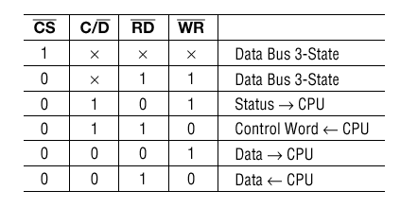
Table 1 shows the operation between a CPU and the device.
Control Words
There are two types of control word.
1.Mode instruction (setting of function)
2.Command (setting of operation)

Slide 10
Mode Instruction
Mode instruction is used for setting the function of the 8251. Mode instruction will be in "wait for write" at either internal reset or external reset. That is, the writing of a control word after resetting will be recognized as a "mode instruction."
Items set by mode instruction are as follows:
• Synchronous/asynchronous mode
• Stop bit length (asynchronous mode)
• Character length
• Parity bit
• Baud rate factor (asynchronous mode)
• Internal/external synchronization (synchronous mode)
• Number of synchronous characters (Synchronous mode)

Slide 11
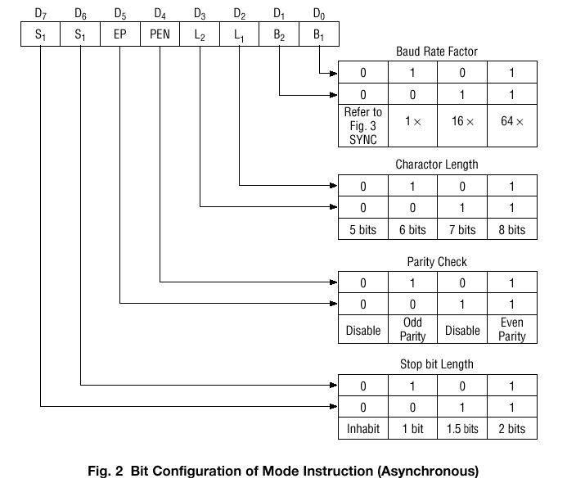
Bit configuration of mode instruction

Slide 12
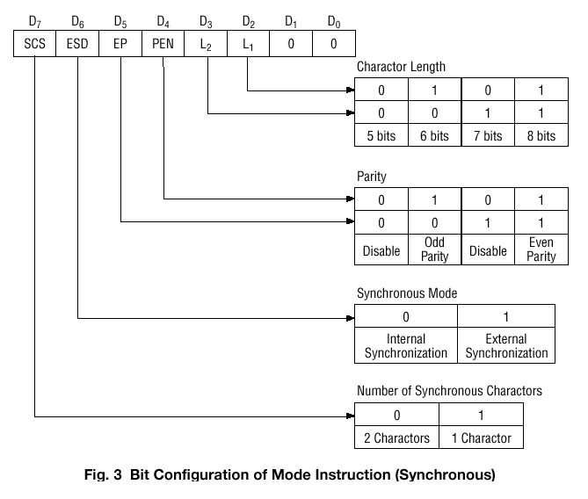

Slide 13
2) Command
Command is used for setting the operation of the 8251. It is possible to write a command whenever necessary after writing a mode instruction and sync characters.
Items to be set by command are as follows:
• Transmit Enable/Disable
• Receive Enable/Disable
• DTR, RTS Output of data.
• Resetting of error flag.
• Sending to break characters
• Internal resetting

Slide 14
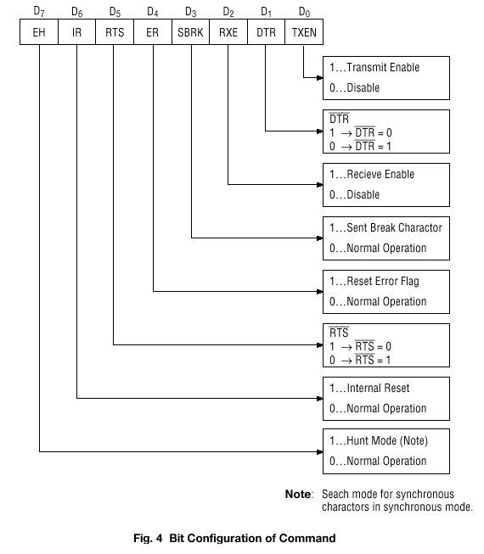

Slide 15
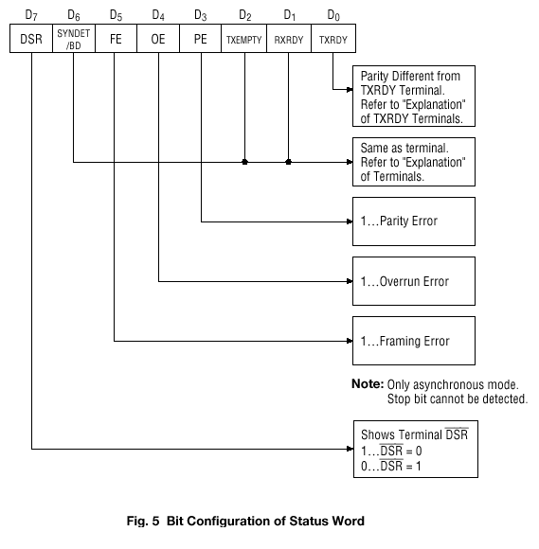
Status Word
It is possible to see the internal status of the 8251 by reading a status word. The bit configuration of status word is shown below.

Slide 16
8253
TIMER

Slide 17
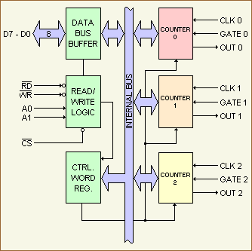
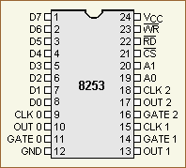
Clock: This is the clock input for the counter. The counter is 16 bits. The maximum clock frequency is 1 / 380 nanoseconds or 2.6 megahertz. The minimum clock frequency is DC or static operation.
Out: This single output line is the signal that is the final programmed output of the device. Actual operation of the out line depends on how the device has been programmed.
Gate: This input can act as a gate for the clock input line, or it can act as a start pulse, depending on the programmed mode of the counter.

Slide 18
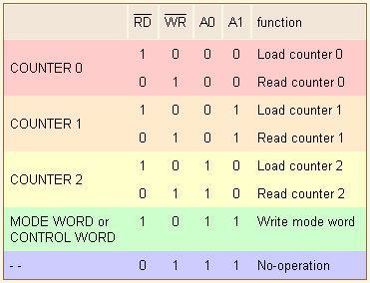
Counter #0, #1, #2 :- Each counter is identical, and each consists of a 16-bit, pre-settable, down counter. Each is fully independent and can be easily read by the CPU. When the counter is read, the data within the counter will not be disturbed. This allows the system or your own program to monitor the counter's value at any time, without disrupting the overall function of the 8253.
Control Word Register :-This internal register is used to write information to, prior to using the device. This register is addressed when A0 and A1 inputs are logical 1's. The data in the register controls the operation mode and the selection of either binary or BCD ( binary coded decimal ) counting format. The register can only be written to. You can't read information from the register

Slide 19

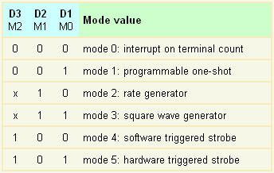
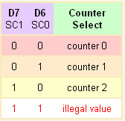

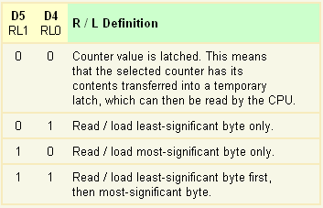
Bits D5 and D4 ( RL1 / RL0 ) of the control word shown above are defined as the read / load mode for the register that is selected by bits D7 and D6. Bits D5 and D4 define how the particular counter is to have data read from or written to it by the CPU.

Slide 20
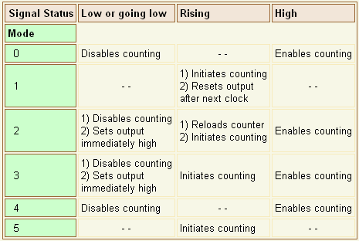
This table shows the different uses of the 8253 gate input pin.
Each mode of operation for the counter has a different use for the GATE input pin.

Slide 21
Mode 0 | Interrupt on Terminal Count The counter will be programmed to an initial value and afterwards counts down at a rate equal to the input clock frequency(8 MHz). When the count is equal to 0, the OUT pin will be a logical 1. The output will stay a logical 1 until the counter is reloaded with a new value or the same value or until a mode word is written to the device. Once the counter starts counting down, the GATE input can disable the internal counting by setting the GATE to a logical 0.
Mode 1 | Programmable One-Shot In mode 1, the device can be setup to give an output pulse that is an integer number of clock pulses. The one-shot is triggered on the rising edge of the GATE input. If the trigger occurs during the pulse output, the 8253 will be retriggered again.
Mode 2 | Rate Generator The counter that is programmed for mode 2 becomes a "divide by n" counter. The OUT pin of the counter goes to low for one input clock period. The time between the pulses of going low is dependent on the present count in the counter's register. I mean the time of the logical 1 pulse. For example, suppose to get an output frequency of 1,000 Hz ( Hertz ), the period would be 1 / 1,000 s = 1 ms ( millisecond ) or 1,000 µs ( microseconds ). If an input clock of 1 MHz ( Mega-Hertz ) were applied to the clock input of the counter #0, then the counter #0 would need to be programmed to 1000 µs. This could be done in decimal or in BCD. ( The period of an input clock of 1 MHz is 1 / 1,000,000 = 1 µs. ) The formula is: n=f_{i} divided by f_{out}. f_{i} = input clock frequency, f_{out} = output frequency, n = value to be loaded.

Slide 22
Mode 3 | Square Wave Generator Mode 3 is similar to the mode 2 except that the output will be high for half the period and low for half. If the count is odd, the output will be high for ( n + 1 ) / 2 and low for ( n - 1 ) / 2 counts.
Mode 4 | Software Triggered Strobe In this mode the programmer can set up the counter to give an output timeout starting when the register is loaded. On the terminal count, when the counter equals to 0, the output will go to a logical 0 for one clock period and then returns to a logical 1. First the mode is set, the output will be a logical 1.
Mode 5 | Hardware Triggered Strobe In this mode the rising edge of the trigger input will start the counting of the counter. The output goes low for one clock at the terminal count. The counter is retriggerable, thus meaning that if the trigger input is taken low and then high during a count sequence, the sequence will start over. When the external trigger input goes to a logical 1, the timer will start to time out. If the external trigger occurs again, prior to the time completing a full timeout, the timer will retrigger.

Slide 23
8255
PPI

Slide 24
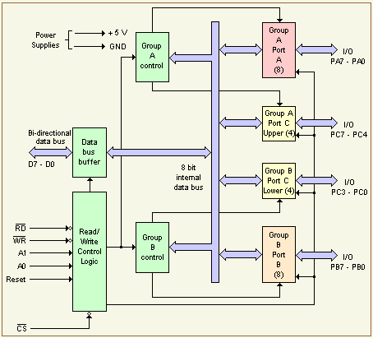
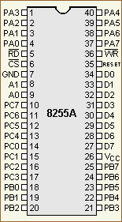

Slide 25
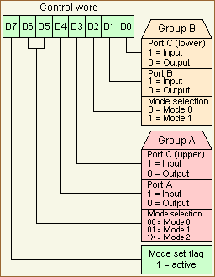
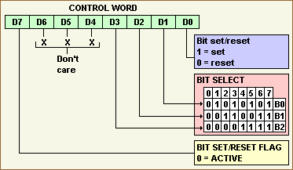
Examples:
If you want to set/reset bit 0 of port C then set D3 to D1 to 000.
Bit 1 of port C will be set/reset if you code 001 to D3 to D1.
Bit 6 of port C is set/reset if D3 to D1 is 110.

Slide 26
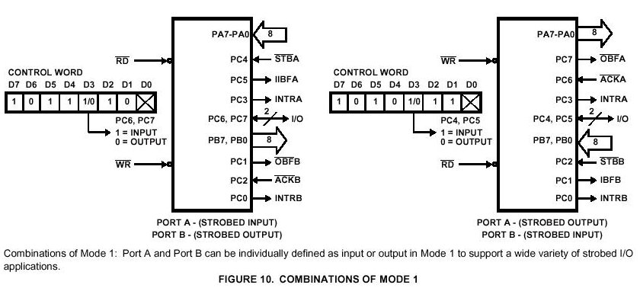

Slide 27
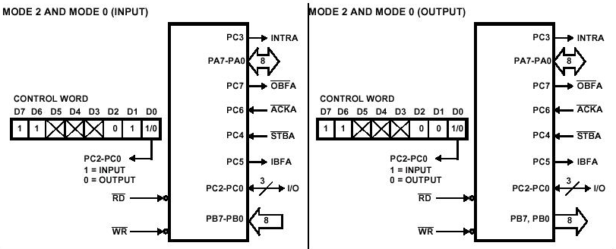
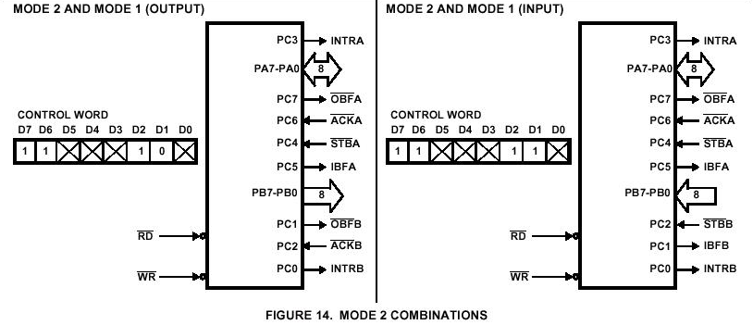

Slide 28
8237
DMA Controller

Slide 29
Direct memory access
Direct memory access (DMA) is a process in which an external device takes
over the control of system bus from the CPU.
DMA is for high-speed data transfer from/to mass storage peripherals, e.g. harddisk
drive, magnetic tape, CD-ROM, and sometimes video controllers.
For example, a hard disk may boasts a transfer rate of 5 M bytes per second, i.e.
1 byte transmission every 200 ns. To make such data transfer via the CPU is
both undesirable and unnecessary.
The basic idea of DMA is to transfer blocks of data directly between memory and
peripherals. The data don’t go through the microprocessor but the data bus is
occupied.
“Normal” transfer of one data byte takes up to 29 clock cycles. The DMA transfer
requires only 5 clock cycles.
Nowadays, DMA can transfer data as fast as 60 M byte per second. The transfer
rate is limited by the speed of memory and peripheral devices.

Slide 30
Basic process of DMA
For 8088 in maximum mode:
The RQ/GT1 and RQ/GT0 pins are used to issue DMA request and receive
acknowledge signals.
Sequence of events of a typical DMA process
1) Peripheral asserts one of the request pins, e.g. RQ/GT1 or RQ/GT0 (RQ/GT0 has higher priority)
2) 8088 completes its current bus cycle and enters into a HOLD state
3) 8088 grants the right of bus control by asserting a grant signal via the same pin as the request signal.
4) DMA operation starts
5) Upon completion of the DMA operation, the peripheral asserts the request/grant pin again to relinquish bus control.
For 8088 in minimum mode:
The HOLD and HLDA pins are used instead to receive and acknowledge the
hold request respectively.
Normally the CPU has full control of the system bus. In a DMA operation, the
peripheral takes over bus control temporarily.

Slide 31
Peripheral to memory transfer with DMA
1(a): μP is executing its main program. It has already configured the DMA ctrl registers.
1(b): P1 receives input data in a register with address 0x8000.
Time
4: After executing instruction 100, μP sees Dreq asserted, releases the system bus, asserts Dack, and resumes execution. μP stalls only if it needs the system bus to continue executing.
3: DMA ctrl asserts Dreq to request control of system bus.
2: P1 asserts req to request servicing by DMA ctrl.
5: (a) DMA ctrl asserts ack (b) reads data from 0x8000 and (b) writes that data to 0x0001.
6:. DMA de-asserts Dreq and ack completing handshake with P1.
7(a): μP de-asserts Dack and resumes control of the bus.
7(b): P1 de-asserts req.

Slide 32
Peripheral to memory transfer with DMA (cont’)
1(a): μP is executing its main program. It has already configured the DMA ctrl registers
1(b): P1 receives input data in a register with address 0x8000.
Program memory
μP
Data memory
0x0000
0x0001
No ISR needed!
System bus
...
Dack
DMA ctrl
P1
Main program
Dreq
...
0x0001
ack
100:
instruction
PC
0x8000
req
101:
instruction
0x8000
100

Slide 33
Peripheral to memory transfer with DMA (cont’)
2: P1 asserts req to request servicing
by DMA ctrl.
3: DMA ctrl asserts Dreq to request control of system bus
Program memory
μP
Data memory
0x0000
0x0001
No ISR needed!
System bus
...
Dack
DMA ctrl
DMA ctrl
P1
P1
Main program
Dreq
P1
...
Dreq
0x0001
ack
100:
instruction
1
PC
req
101:
instruction
0x8000
req
0x8000
100
1

Slide 34
Peripheral to memory transfer with DMA (cont’)
4: After executing instruction 100, μP sees Dreq asserted, releases the system bus, asserts Dack, and resumes execution, μP stalls only if it needs the system bus to continue executing.
Program memory
μP
Data memory
0x0000
0x0001
No ISR needed!
System bus
...
Dack
1
Main program
Dack
DMA ctrl
P1
...
Dreq
0x0001
ack
100:
instruction
PC
0x8000
req
101:
instruction
0x8000
100

Slide 35
Peripheral to memory transfer with DMA (cont’)
5: DMA ctrl (a) asserts ack, (b) reads data from 0x8000, and (c) writes that data to 0x0001.
(Meanwhile, processor still executing if not stalled!)
μP
Data memory
Program memory
Data memory
0x0000
0x0001
0x0000
0x0001
No ISR needed!
System bus
System bus
...
Dack
DMA ctrl
P1
Main program
Dreq
DMA ctrl
1
P1
...
ack
ack
0x0001
ack
0x0001
100:
instruction
PC
req
0x8000
req
0x8000
0x8000
101:
instruction
0x8000
100

Slide 36
Peripheral to memory transfer with DMA (cont’)
6: DMA de-asserts Dreq and ack completing the handshake with P1.
Program memory
μP
Data memory
0x0000
0x0001
No ISR needed!
System bus
...
Dack
DMA ctrl
P1
Main program
Dreq
0
...
Dreq
ack
0
0x0001
ack
100:
instruction
PC
0x8000
req
101:
instruction
0x8000
100

Slide 37
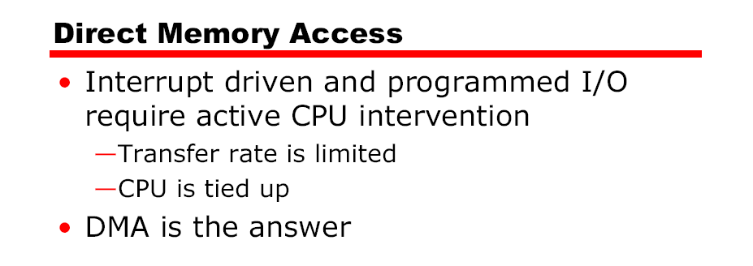
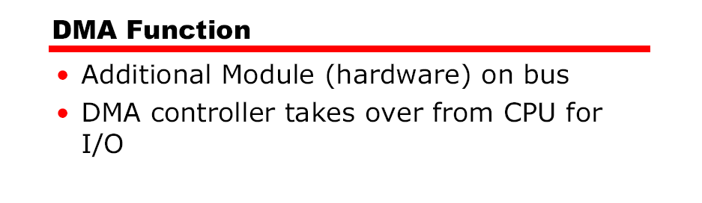

Slide 38
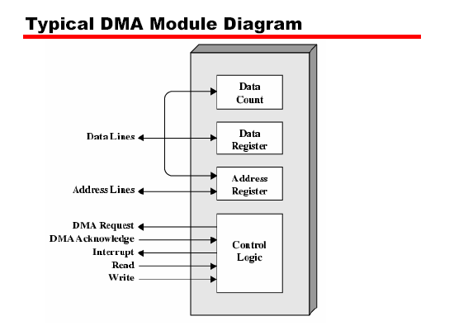

Slide 39
DMA controller
A DMA controller interfaces with several peripherals that may request DMA.
The controller decides the priority of simultaneous DMA requests
communicates with the peripheral and the CPU, and provides memory
addresses for data transfer.
DMA controller commonly used with 8086 is the 8237 programmable device.
The 8237 is a 4-channel device. Each channel is dedicated to a specific
peripheral device and capable of addressing 64 K bytes section of memory.

Slide 40
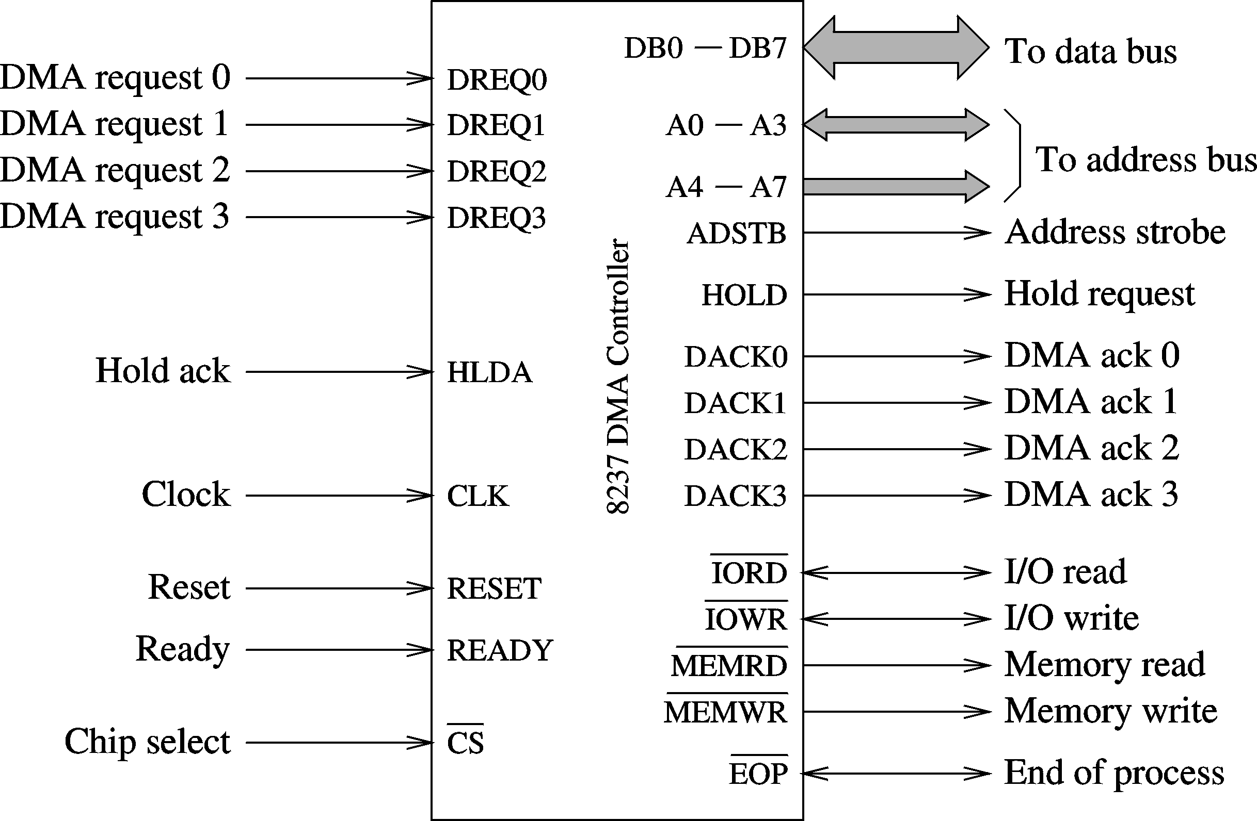
8237 - DMA Controller
8237 DMA controller

Slide 41
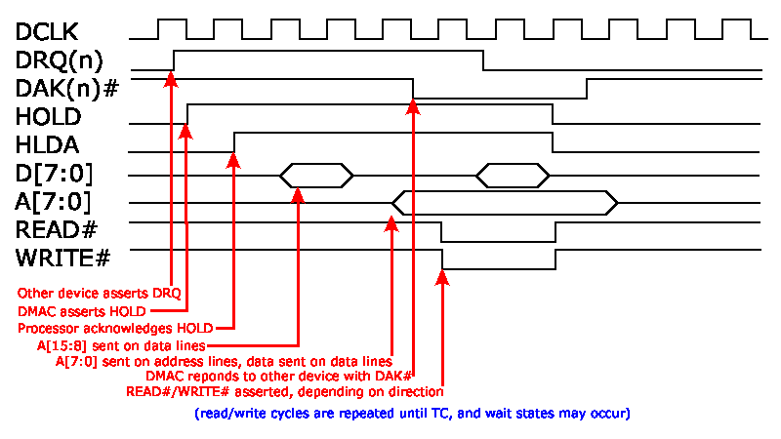

Slide 42
8237 supports four DMA channels
It has the following internal registers
  1.Current address register
    One 16-bit register for each channel
    Holds address for the current DMA transfer
  2.Current word register
    Keeps the byte count
    Generates terminal count (TC) signal when the count goes from zero to FFFFH
  3.Command register
    Used to program 8257 (type of priority, …)

Slide 43
  4.Mode register
    Each channel can be programmed to
      Read or write
      Autoincrement or autodecrement the address
      Autoinitialize the channel
  5.Request register
    For software-initiated DMA
  6.Mask register
    Used to disable a specific channel
  7.Status register
  8.Temporary register
    Used for memory-to-memory transfers

Slide 44
8237 supports four types of data transfer
  Single cycle transfer
    Only single transfer takes place
    Useful for slow devices
  Block transfer mode
    Transfers data until TC is generated or external EOP signal is received
  Demand transfer mode
    Similar to the block transfer mode
    In addition to TC and EOP, transfer can be terminated by deactivating DREQ signal
  Cascade mode
    Useful to expand the number channels beyond four

Slide 45
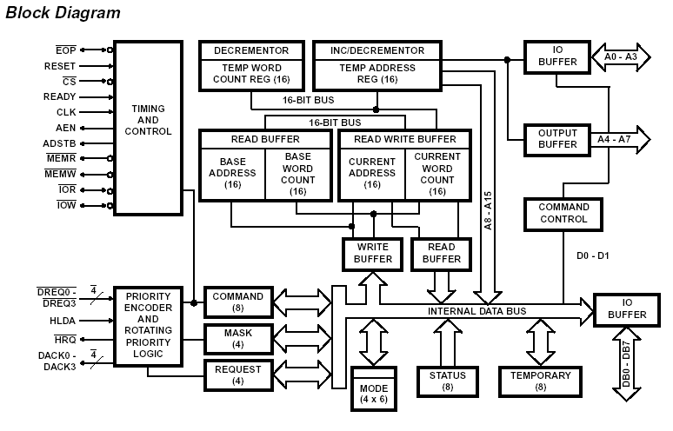

Slide 46
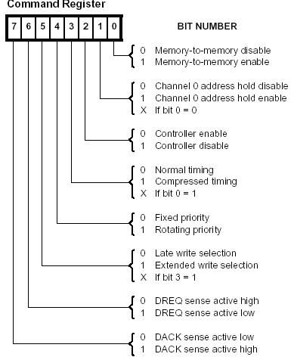

Slide 47
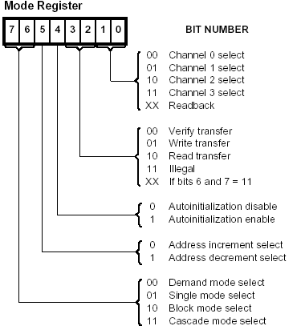

Slide 48
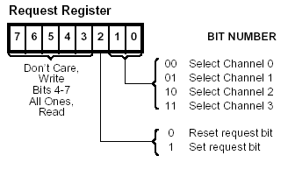
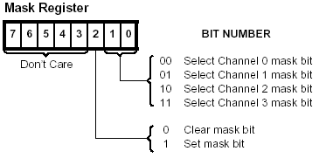

Slide 49
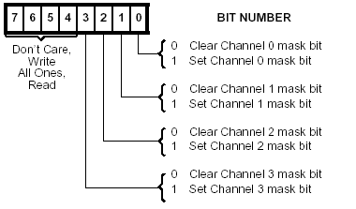
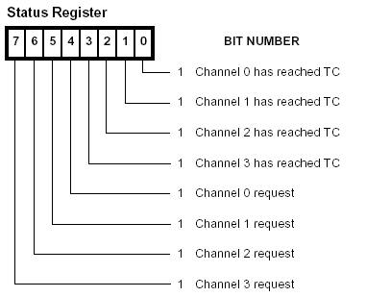

Slide 50
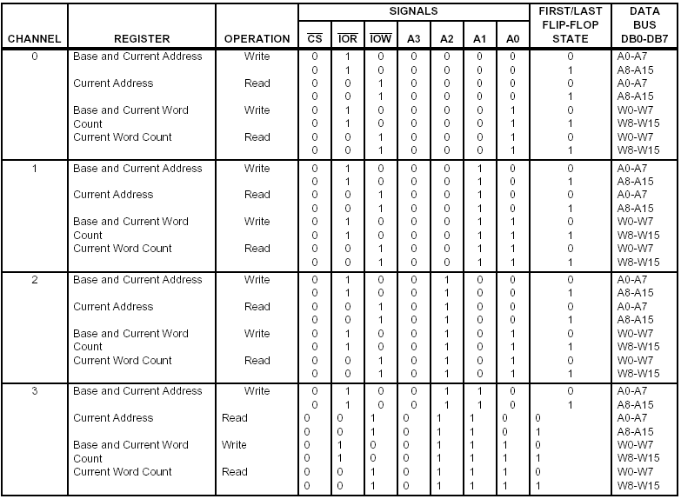

Slide 51
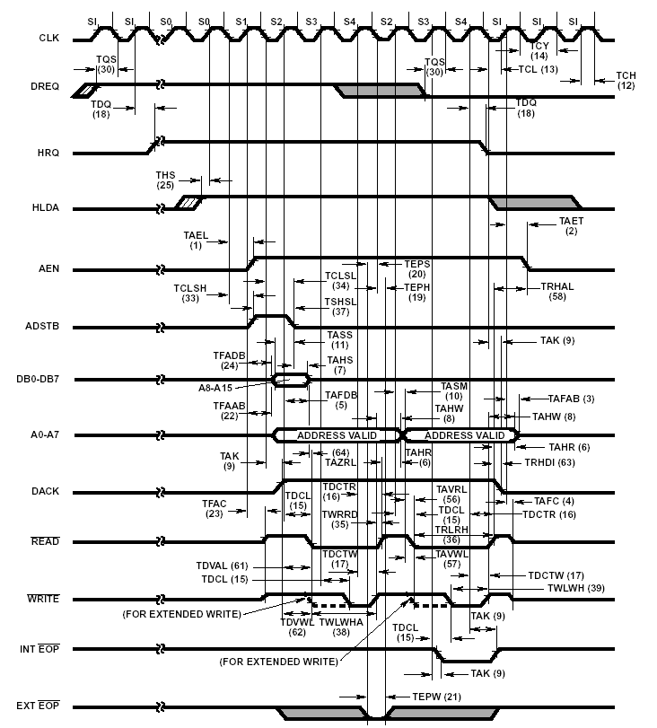

Slide 52
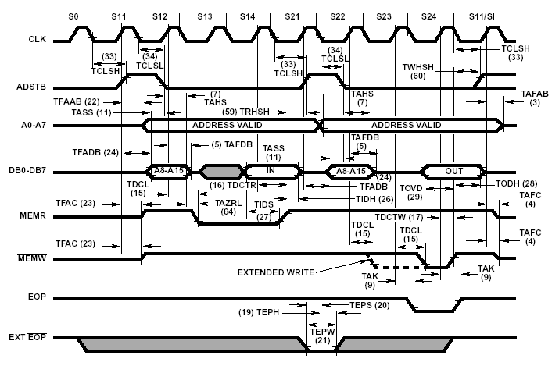

Slide 53
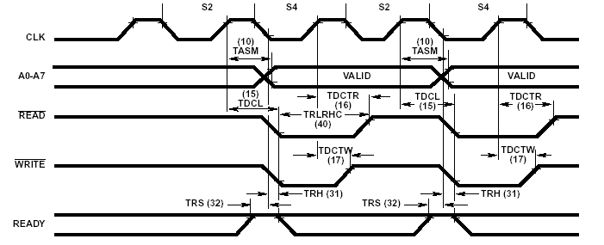

Slide 54
8259
Programable Interrupt Controler

Slide 55
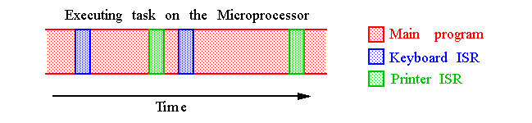
8086 Interrupt Basics
The Intel microprocessors support:
1.Hardware interrupts through:
Two pins that allow interrupt requests, INTR and NMI
One pin that acknowledges, INTA, the interrupt requested
on INTR.
2.Software interrupts through instructions:
INT, INTO, INT 3, BOUND
Control is provided through:
IF and TF flag bits
IRET and IRETD

Slide 56
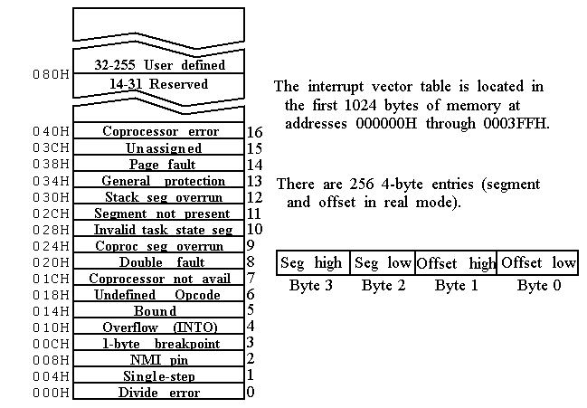
Interrupt Vector Table

Slide 57
Interrupt Steps
1.FLAGS is pushed onto the stack
2.Both the interrupt (IF) and trap (TF) flags are cleared, which
disables the INTR pin and the trap or single-step feature.
3.The CS and IP are pushed onto the stack.
4.The interrupt vector contents are fetched and loaded into CS and
IP and execution resumes in the ISR.
5.On IRET, CS, IP and FLAGS are popped.
6. IF and TF are set to the state prior to the interrupt.

Slide 58
• Eight-Level Priority Controller, Expandable to 64 Levels.
• Programmable Interrupt Modes.
• Individual Request Mask Capability.

Slide 59
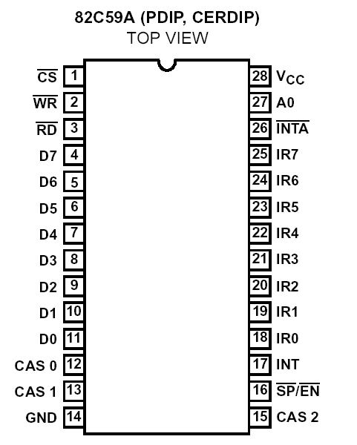
PIN DIAGRAM

Slide 60
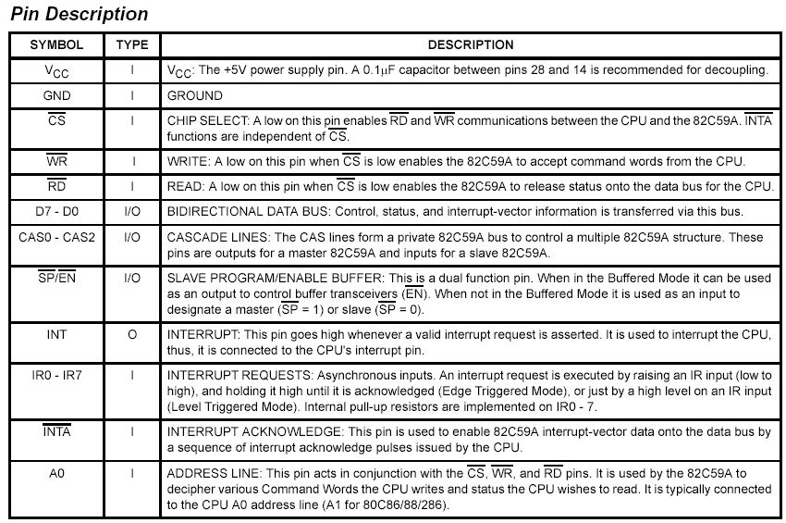

Slide 61
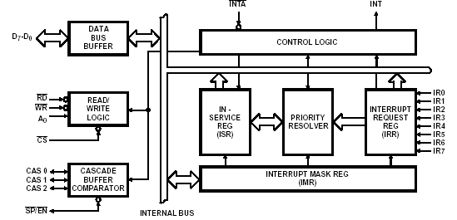
BLOCK DIAGRAM

Slide 62
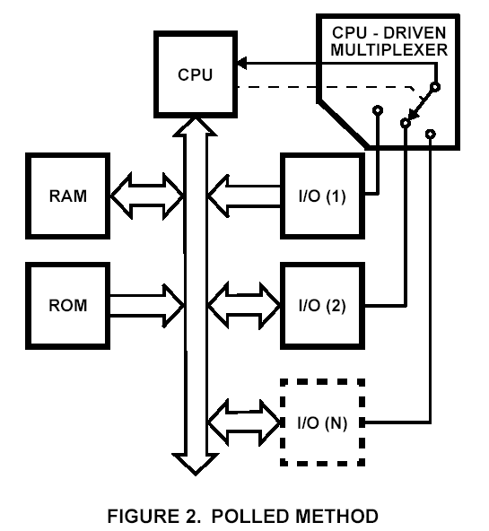
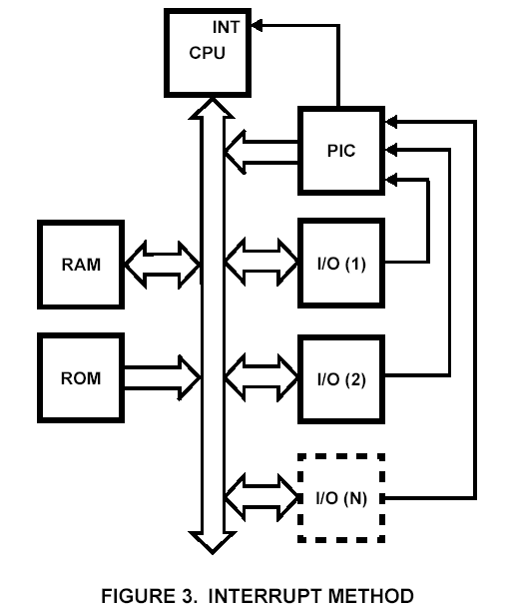
I/O ASSERTING METHODS
This is where the processor must test each device in sequence and in effect “ask” each one if it needs servicing.
Allow the microprocessor to be executing its main program and only stop to service peripheral devices when it is told to do so by the device itself.

Slide 63
The (PlC) functions as an overall manager in an Interrupt-Driven system.
It accepts requests from the peripheral equipment, determines which of the incoming requests is of the highest importance (priority), ascertains whether the incoming request has a higher priority value than the level currently being serviced, and issues an interrupt to the CPU based on this determination.
Each peripheral device or structure usually has a special program or “routine” that is associated with its specific functional or operational requirements; this is referred to as a “service routine”.
The PlC, after issuing an interrupt to the CPU, must somehow input information into the CPU that can “point” the Program Counter to the service routine associated with the requesting device.
This “pointer” is an address in a vectoring table and will often be referred to, in this document, as vectoring data.

Slide 64
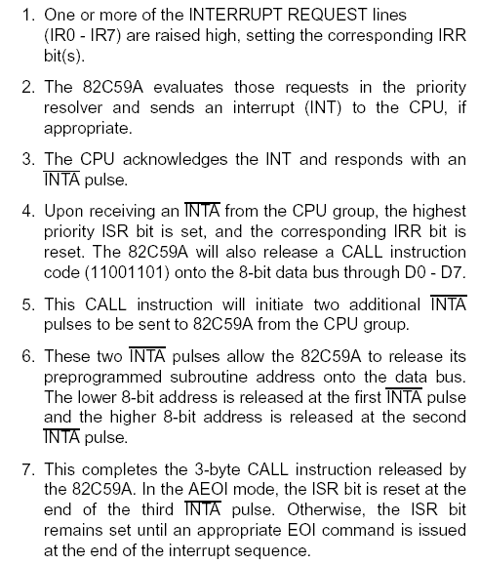

Slide 65
Programming the 82C59A
The 82C59A accepts two types of command words generated by the CPU:
1. Initialization Command Words (ICWs): Before normal operation can begin, each 82C59A in the system must be brought to a starting point - by a sequence of 2 to 4 bytes timed by WR pulses.
2. Operation Command Words (OCWs): These are the command words which command the 82C59A to operate in various interrupt modes. Among these modes are:
a. Fully nested mode.
b. Rotating priority mode.
c. Special mask mode.
d. Polled mode.

Slide 66
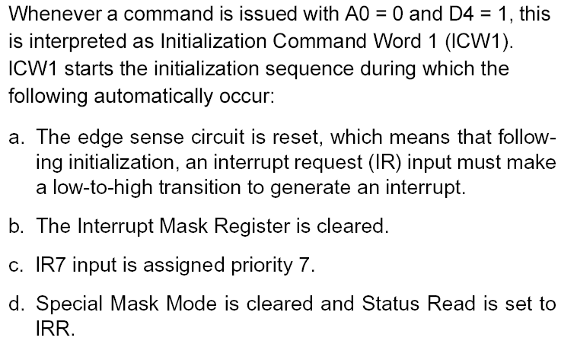
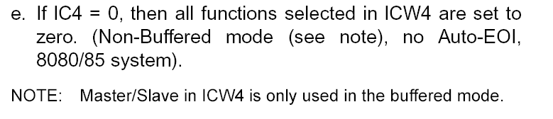
GENERAL

Slide 67
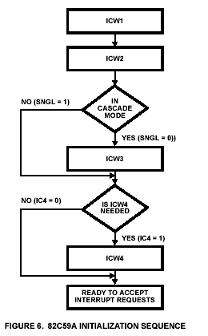

Slide 68
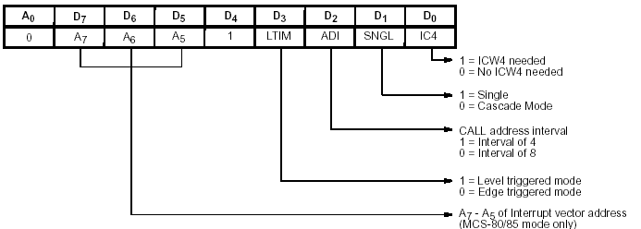
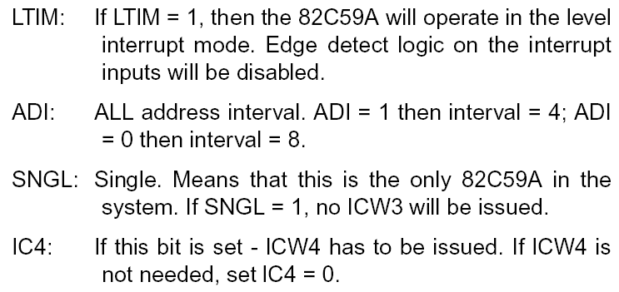
ICW 1

Slide 69
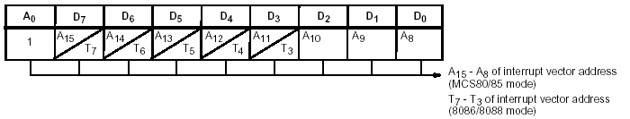
ICW 2

Slide 70


ICW 3

Slide 71

ICW 3 – Slave Device

Slide 72


ICW 4

Slide 73

Operation Command Words

Slide 74


OCW 1

Slide 75


OCW 2

Slide 76


OCW 3

Slide 77
8279
Keyboard Display Interface

Slide 78
8279 – General Points
Scans and encodes up to a 64-key keyboard.
Controls up to a 16-digit numerical display.
Keyboard has a built-in FIFO 8 character buffer to store the keyboard Entries and an Interrupt signal with each
Entry.
The display is controlled from an internal 16x8 RAM that stores the coded display information

Slide 79


Pin diagram

Slide 80
A0: Selects data (0) or control/status (1) for reads and writes between micro and 8279.
BD: Output that blanks the displays.
CLK: Used internally for timing. Max is 3 MHz.
CN/ST: Control/strobe, connected to the control key on the keyboard.
CS: Chip select that enables programming, reading the keyboard, etc.
DB7-DB0: Consists of bidirectional pins that connect to data bus on micro.
IRQ: Interrupt request, becomes 1 when a key is pressed, data is available.
OUT A3-A0/B3-B0: Outputs that sends data to the most significant/least significant nibble of display.
RD(WR): Connects to micro's IORC or RD signal, reads data/status registers.
RESET: Connects to system RESET.
RL7-RL0: Return lines are inputs used to sense key depression in the keyboard matrix.
Shift: Shift connects to Shift key on keyboard.
SL3-SL0: Scan line outputs scan both the keyboard and displays.

Slide 81



Slide 82


Slide 83
Block Diagram
Mainly 4 Sections:
1.KeyBoard Section
2.Scan Section
3.Display Section
4. µp Interface Section

Slide 84
Keyboard Section
RL0 – RL7 connected to 8 columns of keyboard
2 modes: 2-key lockout
N key Rollover
FIFO RAM with 8 registers to store 8 keyboard entries and each read in the order of their entries.
Sent IRQ signal when FIFO is not empty

Slide 85
Scan Section
It has a Scan Counter and 4 Scan Lines
Connected to 4 – to – 16 Decoder to generate 16 scan lines
Scan lines can be connected to rows of Matrix Keyboard and Digit drivers of Display

Slide 86
Display Section
8 Output lines divided into 2 groups:
A0 – A3 and B0 – B3
Can be used as 8 or 4/4
BD line for display Blanking
16 X 8 Display RAM

Slide 87
µp Interface Section
Data bus : DB0 – DB7
One IRQ Line
Six interface lines and A0
A0 = 1 ; signals are control/status word

Slide 88
8279 COMMAND WORDS
(A0 = 1)
1. Keyboard/Display Mode
2. Program Clock
3. Read FIFO/Sensor RAM
4. Read Display RAM
5. Write Display RAM
6. Display write inhibit /Blanking
7. Clear
8. End Interrupt/Error mode set

Slide 89
D7,D6,D5 Configurations
D7 | D6 | D5 | Function | Purpose
0 | 0 | 0 | Mode set | Selects the number of display positions, type of key scan...
0 | 0 | 1 | Clock | Programs internal clk, sets scan and debounce times.
0 | 1 | 0 | Read FIFO | Selects type of FIFO read and address of the read.
0 | 1 | 1 | Read Display | Selects type of display read and address of the read.
1 | 0 | 0 | Write Display | Selects type of write and the address of the write.
1 | 0 | 1 | Display write inhibit | Allows half-bytes to be blanked.
1 | 1 | 0 | Clear | Clears the display or FIFO
1 | 1 | 1 | End interrupt | Clears the IRQ signal to the microprocessor.

Slide 90



Slide 91


Slide 92



Slide 93



Slide 94



Slide 95



Slide 96





Slide 97





Slide 98



